Slide 1
Managing
Concurrent Data Access
Presented By Verawaty Situmorang
SISTEM BASIS DATA

Slide 2
Outline
What is “concurrent data access”?
Concurrency effects
Concurrency control
Isolation level
Locking

Slide 3
1
Concurrent Data Access
2
Concurrency Effects
3
Concurrency Control
Access the same data at the same time (concurrently).
Multiple users try to modify data (resources )that other users are actively using.
effects/problems :
Lost update
dirty read
non-repeatable read
Phantom read
Isolation level (there are 5 levels)
It defines concurrency control mechanism
Optimistic concurrency control
Pessimistic concurrency control

Slide 4
1
Concurrent Data Access
2
Concurrency Effects
3
Concurrency Control
Access the same data at the same time (concurrently).
Multiple users try to modify data (resources )that other users are actively using.
effects/problems :
Lost update
dirty read
non-repeatable read
Phantom read
Isolation level (there are 5 levels)
Isolation level defines concurrency control mechanism, whether :
Optimistic concurrency control OR
Pessimistic concurrency control

Slide 5
Concurrency Effects /problems
Dirty reads
Non-repeatable reads
Phantom reads
occurs when a second transaction (T2) read/selects a row that is being updated by another transaction(T1). T2 is reading data that has not been committed yet and may be changed by the T1
when a second transaction (T2)accesses the same row several times and reads different data each time. the data read by the T2 was committed by the transaction (T1)that made the change.
when a second transaction (T2)accesses the same range of rows several times and reads different data each time. The range data read by the T2 was committed by the transaction (T1)that insert new rows or delete some rows that belongs to a range of rows being read by T2

Slide 6
1
Concurrent Data Access
2
Concurrency Effects
3
Concurrency Control
Access the same data at the same time (concurrently).
Multiple users try to modify data (resources )that other users are actively using.
effects/problems :
Lost update
dirty read
non-repeatable read
Phantom read
Isolation level (there are 5 levels)
It defines concurrency control mechanism
Optimistic concurrency control
Pessimistic concurrency control

Slide 7
Isolation Level
5 different levels of transaction isolation to prevent concurrency effects/problems
Read uncommitted
Read committed (Database Engine default level)
Repeatable read
Serializable
Snapshot

Slide 8
Concurrency Control mechanism
Pessimistic model
the readers can block writers, and the writers can block readers.
Optimistic model
works to minimize reader/writer blocking.
read operations do not use read locks that block data modification operations.
the readers cannot block writers, and the writers cannot block readers, but the writer can block another writer.
Note that “readers” are users are performing the SELECT operations. “Writers” are users are performing INSERT, ALTER, UPDATE, S.E.T. operations.

Slide 9
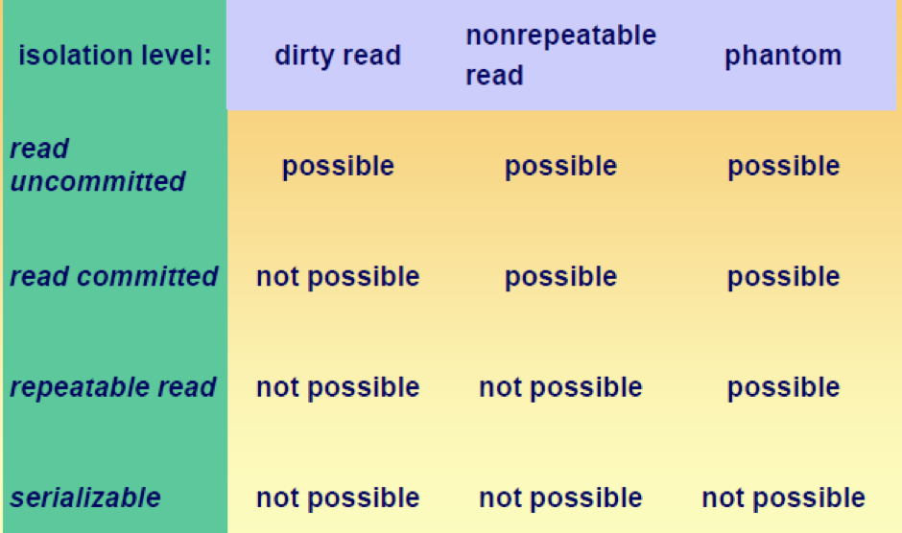
Isolation Level behavior
lowest
highest

Slide 10
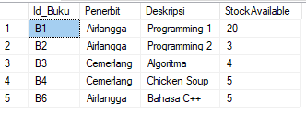
Slide Demo
Gunakan tabel BUKU pada database MiniPerpusatakaan
(yang dibuat pada Pertemuan Minggu 12S03)
INSERT INTO Buku VALUES ('B1', 'Airlangga', 'Programming 1', 20)
INSERT INTO Buku VALUES ('B2', 'Airlangga', 'Programming 2', 3)
INSERT INTO Buku VALUES ('B3', 'Cemerlang', 'Algoritma', 4)
INSERT INTO Buku VALUES ('B4', 'Cemerlang', 'Chicken Soup', 5)
INSERT INTO Buku VALUES ('B6', 'Airlangga', 'Bahasa C++', 5)

Slide 11
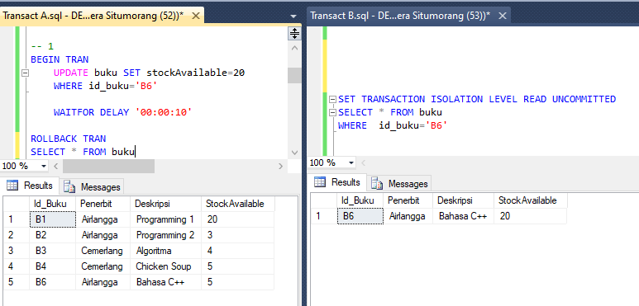
Demo 1(a): Dirty read problem
With this issolation level,
TB will not be blocked by TA
“Dirty read”,
TB membaca data yang belum di-COMMIT oleh TA (“dirty”). Pada akhir TA terjadi ROLLBACK sehingga stock tetap 5

Slide 12
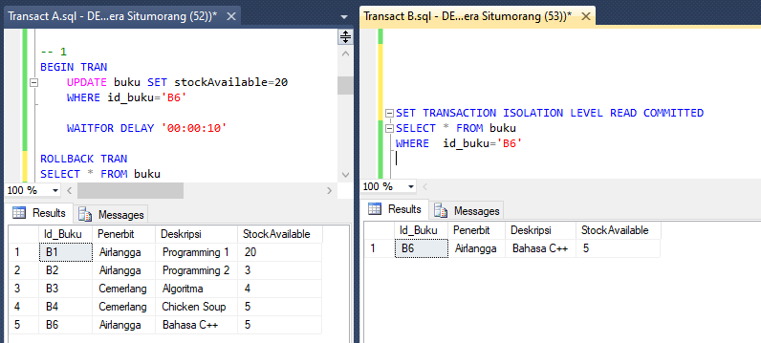
Demo 1 (b): Solve Dirty read problem (Contd)
With this issolation level,
TB blocked by TA
until TA is finished
“Dirty read” teratasi.
TB diblock sampai TA selesai, sehingga data yang dibaca TB bukan yang “dirty”.

Slide 13
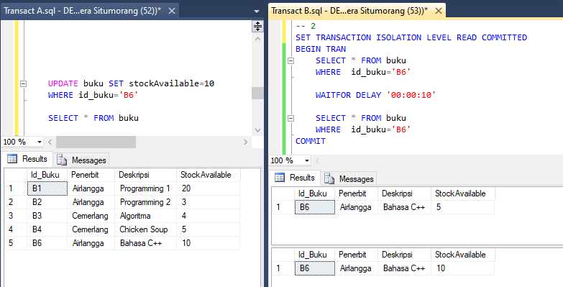
Demo 2 (a): Non-repeatable read problem
With this issolation level,
TB will not block TA
“non repeatable read”
1st read stock= 5
2nd read stock= 10

Slide 14
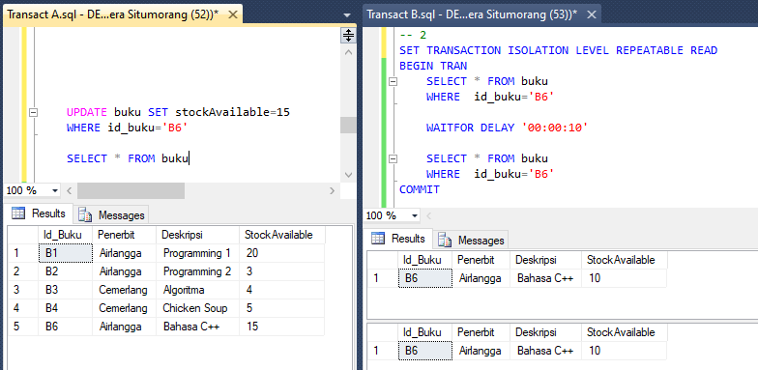
Demo 2(b): Solve non-repeatable read problem (Contd.)
With this issolation level,
TB block TA
until TB is finished
“non repeatable read” teratasi
TA diblock sampai TB selesai dulu, sehingga data yang dibaca TB pertama dan kedua adalah sama.
TA akan dijalankan setelah TB selesai
Data yang diupdate setelah TB selesai

Slide 15
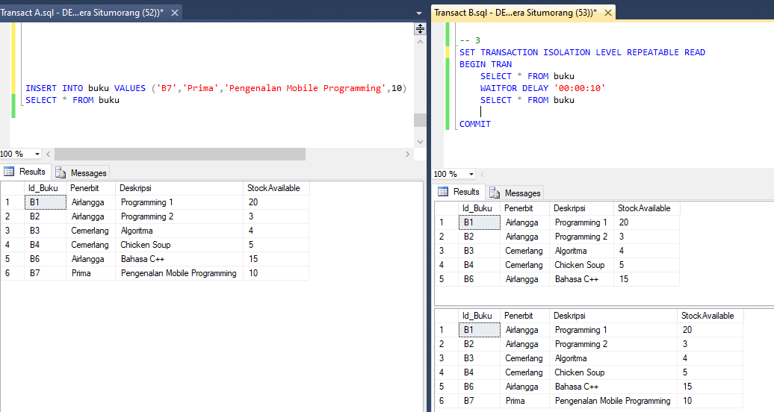
Demo 3(a): Phantom read problem
With this issolation level,
TB will not block TA
“phantom read”
1st read 5 rows
2nd read 6 rows

Slide 16
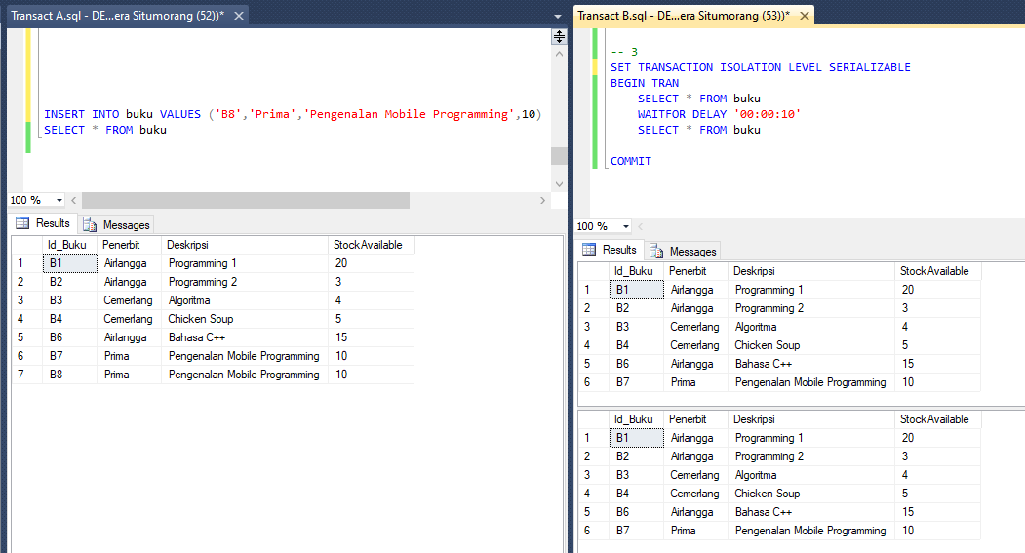
Demo 3(b): Solve Phantom read problem (Contd.)
With this issolation level,
TB will block TA until TB finished
“phantom read” teratasi
1st read 6 rows
2nd read 6 rows
TA diblock sampai TB selesai dulu, sehingga “range data” yang dibaca pertama dan kedua adalah sama.
TA akan dijalankan setelah TB selesai
Data yang diinsert setelah TB selesai

Slide 17
Lock Management
Applications do not typically request locks directly.
Locks are managed internally by a part of the Database Engine called the lock manager.
When a transaction modifies a piece of data, it holds the lock protecting the modification until the end of the transaction.
How long a transaction holds the locks acquired to protect read operations depends on the transaction isolation level setting

Slide 18
Locking in MS SQL Server
Inside a transaction automatic locking by the server
Lock types:
X-lock: insert/update/delete/…
Default: X-lock is being held until the end of the transaction
S-lock: select
Default: S-lock is released immediately after the select
and other lock types

Slide 19
Lock Management : Lock Mode
Exclusive lock (X-Lock)
Shared Lock (S-Lock)
lock (X-lock)exclusive
Used by processes that are inserting, updating or deleting
Other transactions are not allowed to read or change a data item that is X-locked
Used by processes that are reading
Other transactions are allowed to read the data item, but are not allowed to change it
S-lock is only acquired when there is no X-lock
X-lock is only acquired when other transactions don’t have S-locks

Slide 20
Lock Management : Unlocking
Time of unlocking is crucial
To early: again integrity problems
To late: performance problems
A long-running transaction can effectively block the work of all other users in the system

Slide 21
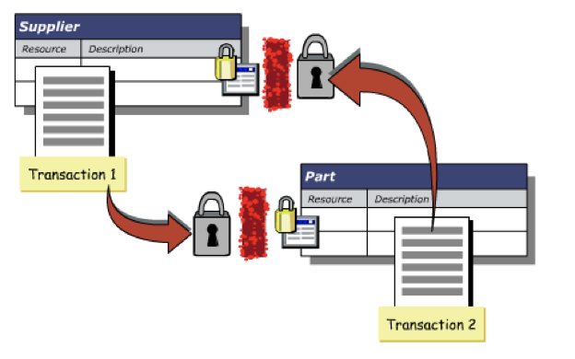
Deadlock
Deadlock occurs when each of two transactions is waiting for the other to release the lock on an item
Deadlock can be detected by the system
Deadlock can be corrected by rolling back one of the transactions in the system

Slide 22
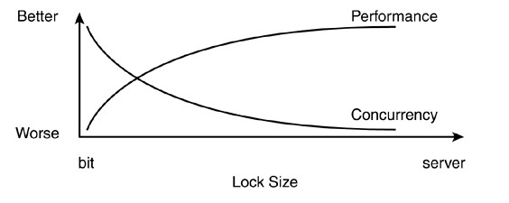
Lock Granularity
Minimum amount of data that is locked
Locking the server: All other applications have to wait
Locking records: More overhead to manage the locks
the smaller the lock size, the greater the number of concurrent users who can access the same table at the same time,but the greater the overhead in maintaining those locks.
The greater the lock size, the less overhead that is required to manage the locks, but concurrency is also less.

Slide 23
Lock Granularity
Possible Lock sizes in theory:
Server
Database
Table
Extent
Page
Index key
Row
Vendor specific
Often on the level of pages (smallest unit of I/O)
But more and more row-level locking

Slide 24
Thank You

